Slide 1

Market Share
Top 15 product

Slide 2

Why market share is important?
“Because market share is a key indicator of market competitiveness, it enables executives to judge total market growth or decline, identify key trends in consumer behavior and see their market potential and market opportunity.”
----Buxton
Notes:
“Market Share: The Most Important Metric for Business Success”, Buxton, https://www.buxtonco.com/blog/market-share-the-most-important-metric-for-business-success#:~:text=Because%20market%20share%20is%20a,market%20potential%20and%20market%20opportunity.

Slide 3
Create main table with original data
create external table if not exists painpilldata (
reporter_dea_no string, reporter_bus_act string, reporter_name string, reporter_addl_co_info string, reporter_address1 string, reporter_address2 string, reporter_city string, reporter_state string, reporter_zip string, reporter_county string, buyer_dea_no string, buyer_bus_act string, buyer_name string, buyer_addl_co_info string, buyer_address1 string, buyer_address2 string, buyer_city string, buyer_state string, buyer_zip string, buyer_county string, transaction_code string, drug_code string, ndc_no string, drug_name string, quantity int, unit int, action_indicator string, order_form_no string, correction_no string, strength string, transaction_date string, calc_base_wt_in_gm float, dosage_unit int, transaction_id string, product_name string, ingredient_name string, measure string, mme_conversion_factor string, combined_labeler_name string, revised_company_name string, reporter_family string, dos_str int )
ROW FORMAT DELIMITED FIELDS TERMINATED BY '\t'
STORED AS TEXTFILE LOCATION '/user/jliu2/Painpill'
TBLPROPERTIES ("skip.header.line.count"="1");

Slide 4
Create a table with Market Share by products
create table if not exists ms_product
row format delimited fields terminated by '\t'
stored as textfile location '/user/jliu2/Painpill/productms'
as
select product_name, sum(quantity) as quantity
from painpilldata group by product_name order by quantity desc;

Slide 5
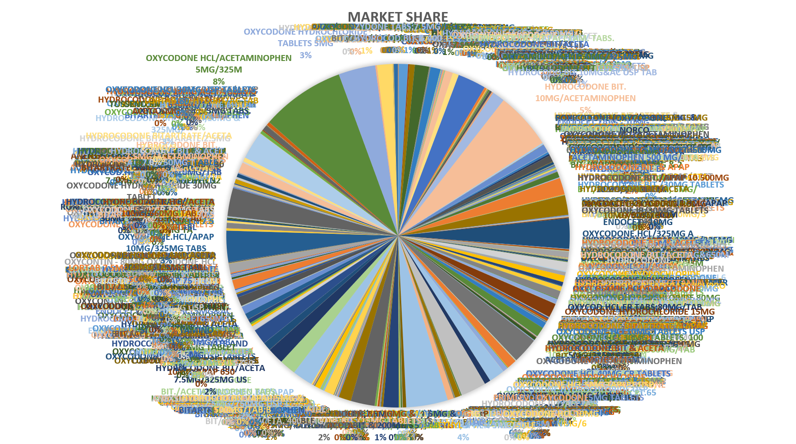
Notes:
967 rows So decide to narrow it down

Slide 6
Create a table with Market Share by Top15 Products
create table if not exists top15msp
row format delimited fields terminated by '\t'
stored as textfile location '/user/jliu2/Painpill/top15ms'
as
with top15 as (
select product_name, quantity from ms_product order by quantity desc limit 15)
select * from top15
union all
select "all other" as product_name, sum(quantity) as quantity
from ms_product
where product_name not in (select product_name from top15)
Notes:
Sub-table top15

Slide 7
Product Name | Quantity
OXYCODONE HCL/ACETAMINOPHEN 5MG/325M | 5482988
HYDROCODONE BIT. 10MG/ACETAMINOPHEN | 3726823
HYDROCODONE BIT/ACETAMINOPHEN 5MG/50 | 2714692
OXYCODONE HYDROCHLORIDE TABLETS 5MG | 2414112
OXYCODONE.HCL/APAP 10MG/325MG TABS | 2029077
ENDOCET - 10MG OXYCODONE.HCL/325MG A | 1974435
HYDROCODONE BIT/ACETA 7.5MG/500MG US | 1848954
OXYCODONE HYDROCHLORIDE 30MG TABLET | 1844479
HYDROCODONE.BIT./ACET.,10MG & 325MG/ | 1835527
OXYCODONE HCL/ACETAMINOPHEN 10MG/325 | 1685845
HYDROCODONE BIT/ACETA 10MG/325MG USP | 1659450
HYDROCODONE BIT 5MG/ACETAMINOPHEN 50 | 1556335
HYDROCODO.BIT/APAP 7.5MG/750MG USP T | 1337008
HYDROCODONE BIT/ACETA 10MG/500MG USP | 1271536
HYDROCODONE BIT. & APAP 5MG/500MG TA | 1087366
all other | 36913915
Notes:
3-D Clustered Bar without all other

Slide 8
Top 15 Painpill Product Market Share

